Slide 1

Anti-drug education for foreign students
PingRong High School

Slide 2
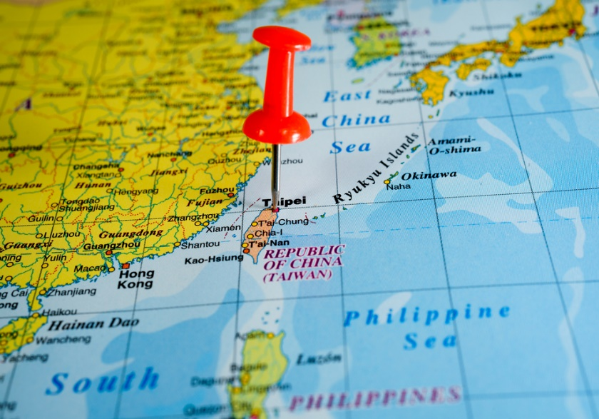
Ice-breaking
Wecome to Taiwan，
Pingtung county，
PingRong senior high school 。

Slide 3

I am the school security officer in charge of anti-drug affairs，My name is Macgyver，Cell phone numbers is 0915425162。

Slide 4

In case of an accident, you should know how to report it and communicate with you Pingtung host family or call student safety center in PingRongsenior high school 。
The student safety center in PingRong senior high school: (08)721-4589

Slide 5
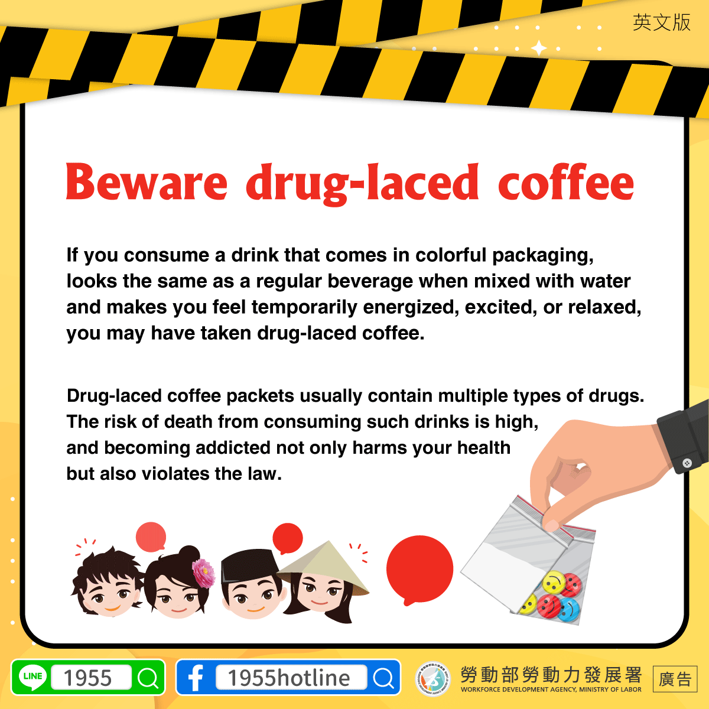

Slide 6


Slide 7


Slide 8


Slide 9


Slide 10


Slide 11


Slide 12
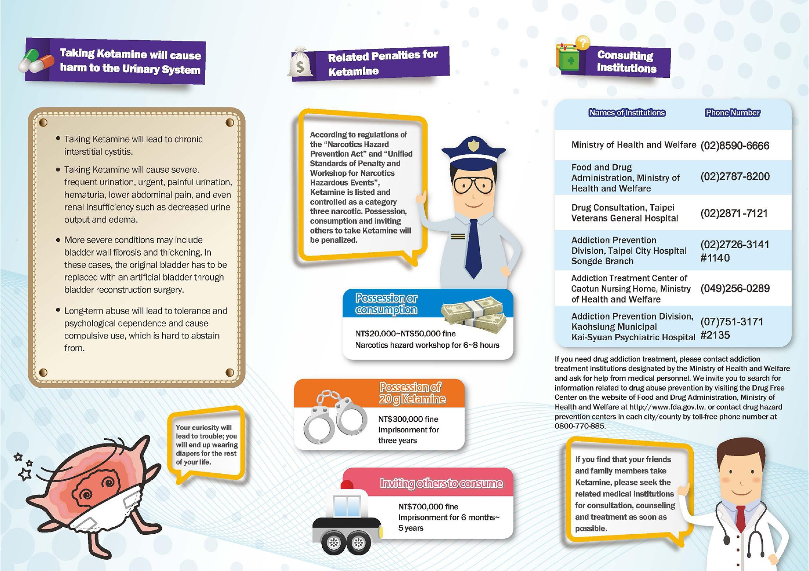

Slide 13


Slide 14
Thank for your watching

